Slide 1
Data Structure and Algorithm: An Introduction
Yuhang Guo

Slide 2
Outline
What is “Data structure”?
Why do we need to learn “Data structure”?

Slide 3




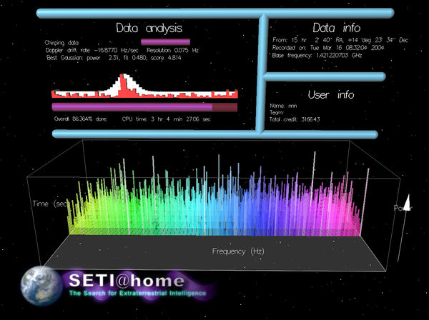

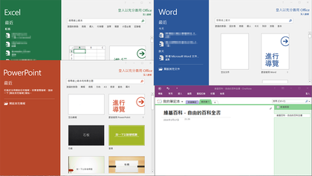
What a computer can do?

Slide 4
Computers can only do TWO things
faster than human brains 🧠
computing
a desktop/notebook computer can execute 1 billion times per second
we have learned the basics of programming language
storing
an ordinary computer can store terabytes of content
let’s learn how to process large amounts of data with computers
larger than traditional media 📚
We need to convert application tasks into
computing and storage tasks that computers are good at

Slide 5


efficiency!
Encyclopædia Britannica (1768-)
32 volumes, 15th edition (2010)
32,640 pages
Wikipedia (2001-)
at least 6,164,266 articles in English (2020)
monthly active users of social networks in 2019
Facebook: 2.41 billion
WeChat: 1.13 billion
Weibo: 465 million
Twitter: 330 million
number of web pages in 2019
5.61 billion
data for the first black hole image (Sagittarius A*, April 1-April 4, 2017)
7 PB (7000 TB) for 5 days collection
How to manage these data?
Notes:
https://www.statista.com/statistics/255778/number-of-active-wechat-messenger-accounts/
https://www.statista.com/statistics/264810/number-of-monthly-active-facebook-users-worldwide/
https://www.statista.com/statistics/282087/number-of-monthly-active-twitter-users/
https://expandedramblings.com/index.php/weibo-user-statistics/
https://www.worldwidewebsize.com/
https://www.computerworld.com/article/2972251/massive-telescope-array-aims-for-black-hole-gets-gusher-of-data.html
人马座A*

Slide 6
data management
search for a word from a dictionary
find a book in a library
find the nearest milk tea store
recommend a movie suitable for dating
Notes:
很多数据大体上是同种类型的，比如字，书，奶茶店，电影。
同类型的个体可能比较多，比如6000个常用汉字，数十万本书若干个奶茶店和电影。
数据结构就是研究如何组织数据的一门学问

Slide 7

Data structure: how the data is viewed
what can you find in this photo?

Slide 8
a pile of books
机械工业出版社，《数据结构与算法分析——C语言描述》，简称DSAAC
清华大学出版社，《数据结构（C语言版）》，简称DS
机械工业出版社，《算法导论》，简称IA
人民邮电出版社，《算法》，简称A
人民邮电出版社，《深度学习》，简称DL

Slide 9
organizations
we have a set of books
{DSAAC, DS, IA, A, DL}
also a sequence of books (from up to down)
(DSAAC, DS, IA, A, DL)
or (from down to up)
(DL, A, IA, DS, DSAAC)

Slide 10
organizations
we can sort them in groups
by press: {清华(DS), 机工(DSAAC, IA), 人邮(A, DL)}
or by content: {data structure(DSAAC, DS), algorithms(A, IA), machine learning(DL)}
we can organize these books according to some reading order suggestions
{<DSAAC, IA>, <DSAAC, A>, <DS, IA>, <DS, A>, <IA, DL>, <A, DL>}

Slide 11
structures
as a result, we can organize the books as
a set
two sequences
two trees
a directed acyclic graph
…
books
DSAAC
DL
清华
机工
人邮
DS
DSAAC
DS
A
DS
DSAAC
IA
A
DL
IA
IA
IA
A
books
A
DS
machine learning
data structure
algorithms
DL
DL
DSAAC
DL
DSAAC
DS
A
IA

Slide 12
data structure
data
the books (press, title, content), the information we are interest in, not a pile of papers
structure
an organization of the books given some relations between them
relations
set, graph, tree, linear

Slide 13
definition
data structures
DSAAC
methods of organizing large amount of data
Dictionary of Algorithms and Data Structures (NIST)
an organization of information, usually in memory, for better algorithm efficiency, such as queue, stack, linked list, heap, dictionary, and tree, or conceptual unity, such as the name and address of a person

Slide 14
We need to organize these data to make better use of them
Data Structure
Algorithm

Slide 15
Why learning this course
Core in computer science
To run the computer program efficiently
Efficient management of data – data structures
Efficient sequence of actions – algorithms
Prerequisite courses of Data Structure and Algorithm Analysis
High-level programming languages
C/C++, Java, Python …
Data Structure and Algorithm Analysis as a prerequisite course for
Operating systems: queue, list, directory tree
Compilers: stack, parsing tree, hash table
Databases: list, index tree
Notes:
实际上，数据结构和算法这门研究来源于操作系统，编译原理，数据库等应用领域，是这些研究过程中总结出来的共性问题

Slide 16
covered topics
abstract data types
data structures
lists, stacks, queues
hash tables, heaps, trees, graphs
basic algorithms
create, destroy, insert, delete, traverse
sort, search
other graph algorithms
algorithm analysis
complexity

Slide 17
course goals
what is your goal?
familiarize yourself with fundamental data structures and algorithms
analysis and compare algorithms
use basic data structure to solve problems
develop your own data structure or algorithm

Slide 18
how to learn this course
learn from the lecture
read the text book carefully
coding
ask questions
make good use of the internet to find the answers
review array, pointer, struct and relevant concepts in C
practice, practice and practice

Slide 19
summary
data structure
organize data with computers

